Slide 1

In a class hierarchy, when a method in a subclass has the same return type and signature as a method in its superclass, then the method in the subclass is said to override the method in the superclass.
When an overridden method is called from within a subclass, it will always refer to the version of that method defined by the subclass.
The version of the method defined by the superclass will be hidden.

Slide 2
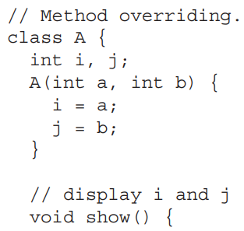


Slide 3
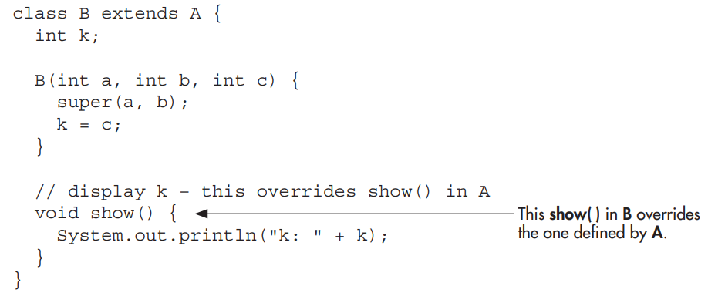

Slide 4
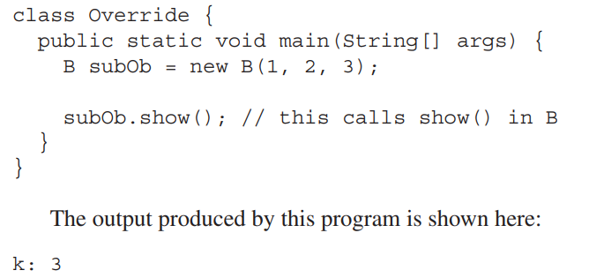

Slide 5
When show( ) is invoked on an object of type B, the version of show( ) defined within B is used. That is, the version of show( ) inside B overrides the version declared in A.

Slide 6
If you want to access the superclass version of an overridden method, you can do so by using super.
For example, in this version of B, the superclass version of show( ) is invoked within the subclass’ version. This allows all instance variables to be displayed.

Slide 7
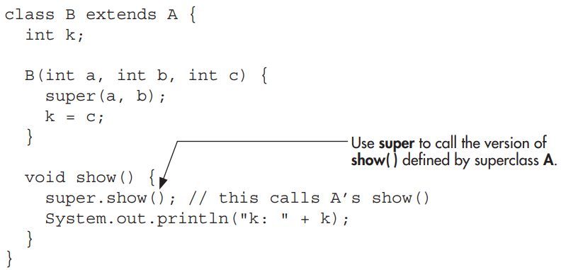

Slide 8

If you substitute this version of show( ) into the previous program, you will see the following output:

Slide 9
Method overriding occurs only when the signatures of the two methods are identical.
If they are not, then the two methods are simply overloaded. For example, consider this modified version of the preceding example:

Slide 10
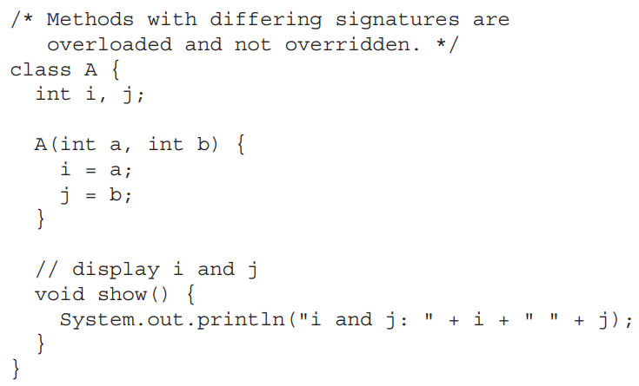

Slide 11
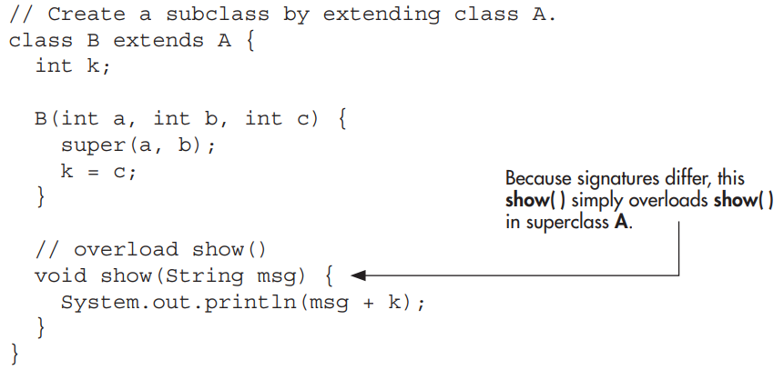

Slide 12

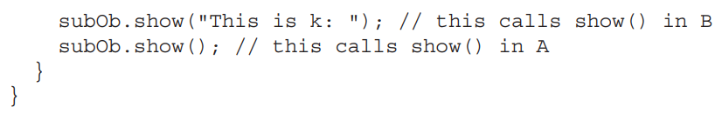
The version of show( ) in B takes a string parameter. This makes its signature different from the one in A, which takes no parameters. Therefore, no overriding (or name hiding) takes place.

Slide 13
While the examples in the preceding section demonstrate the mechanics of method overriding, they do not show its power.
Method overriding forms the basis for one of Java’s most powerful concepts: dynamic method dispatch.

Slide 14
Dynamic method dispatch is the mechanism by which a call to an overridden method is resolved at run time rather than compile time.
Dynamic method dispatch is important because this is how Java implements run-time polymorphism.

Slide 15
Let’s begin by restating an important principle: a superclass reference variable can refer to a subclass object.
Java uses this fact to resolve calls to overridden methods at run time.
Here’s how. When an overridden method is called through a superclass reference, Java determines which version of that method to execute based upon the type of the object being referred to at the time the call occurs.

Slide 16
Thus, this determination is made at run time.
When different types of objects are referred to, different versions of an overridden method will be called.
Therefore, if a superclass contains a method that is overridden by a subclass, then when different types of objects are referred to through a superclass reference variable, different versions of the method are executed.

Slide 17
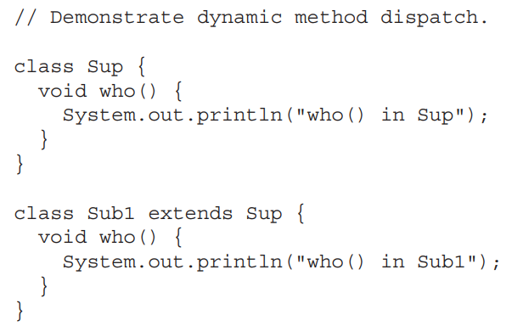
Here is an example that illustrates dynamic method dispatch:

Slide 18
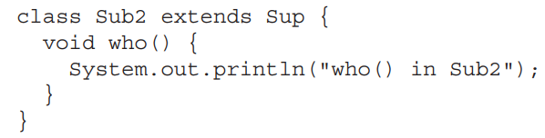

Slide 19
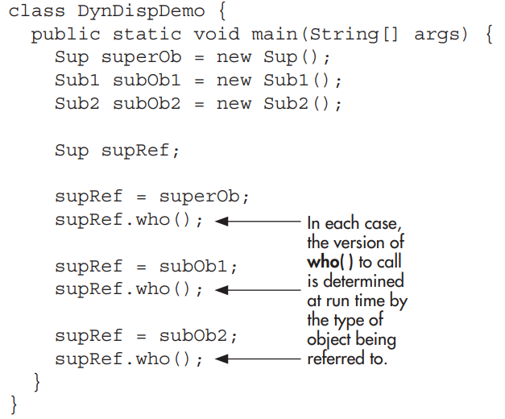

Slide 20
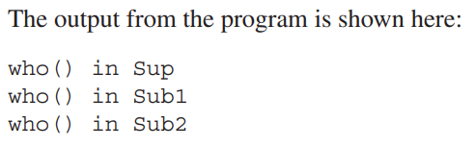

Slide 21

As stated earlier, overridden methods allow Java to support run-time polymorphism.
Polymorphism is essential to object-oriented programming for one reason: it allows a general class to specify methods that will be common to all of its derivatives, while allowing subclasses to define the specific implementation of some or all of those methods.

Slide 22
Overridden methods are another way that Java implements the “one interface, multiple methods” aspect of polymorphism.
Part of the key to successfully applying polymorphism is understanding that the superclasses and subclasses form a hierarchy that moves from lesser to greater specialization.

Slide 23
This allows the subclass the flexibility to define its own methods, yet still enforces a consistent interface.
Thus, by combining inheritance with overridden methods, a superclass can define the general form of the methods that will be used by all of its subclasses

Slide 24
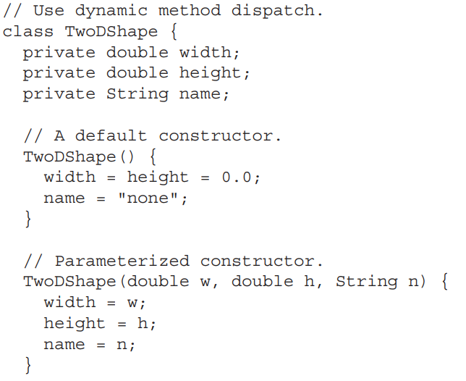

Slide 25
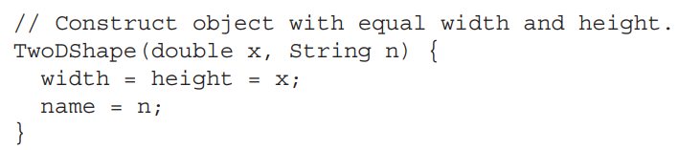
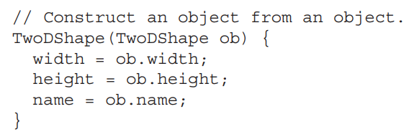

Slide 26
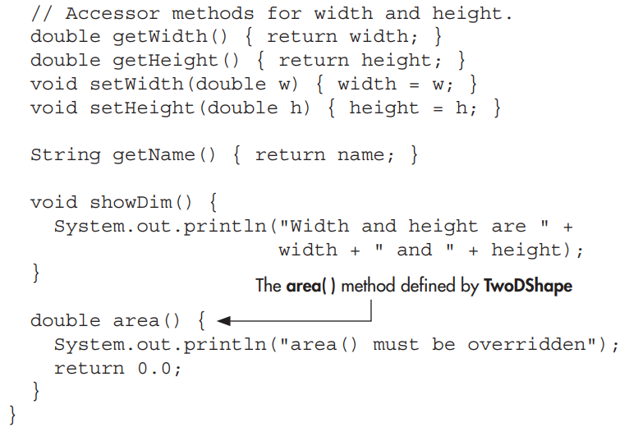

Slide 27
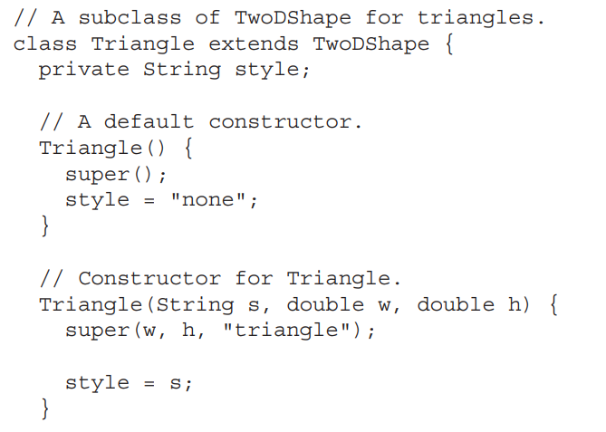

Slide 28
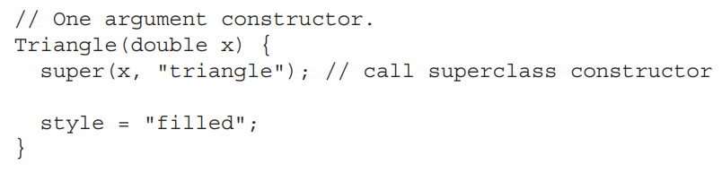
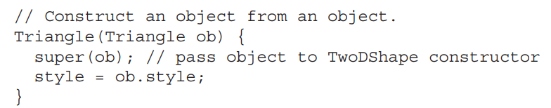

Slide 29
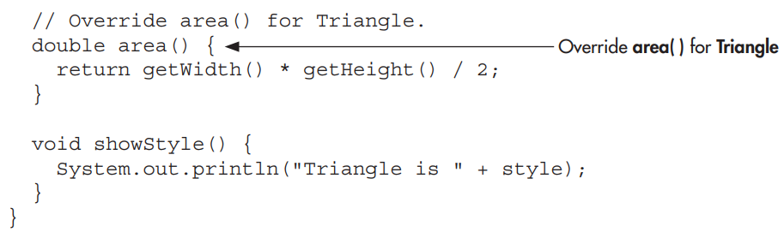

Slide 30
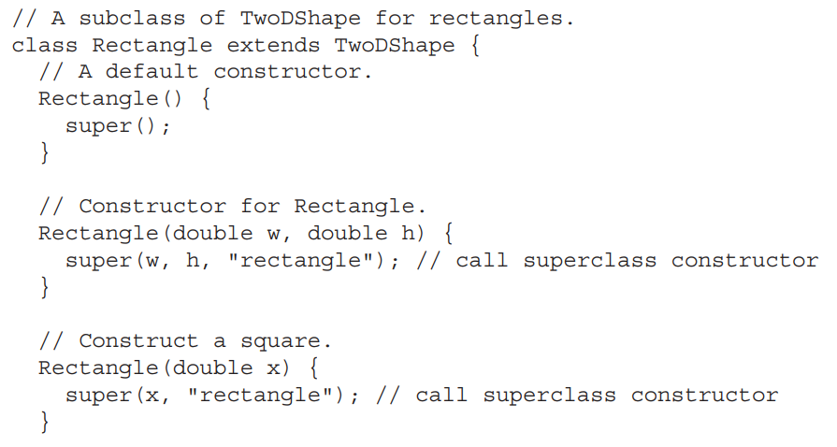

Slide 31
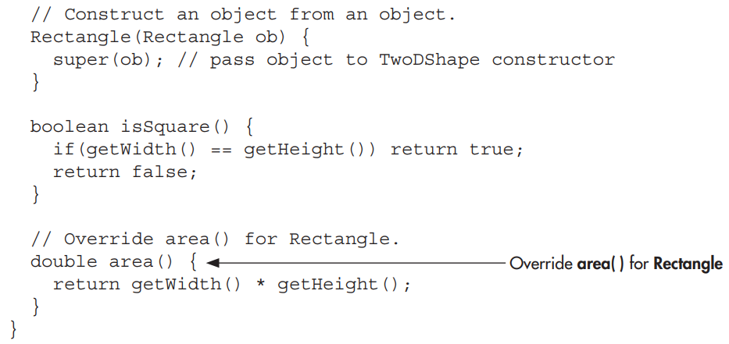

Slide 32
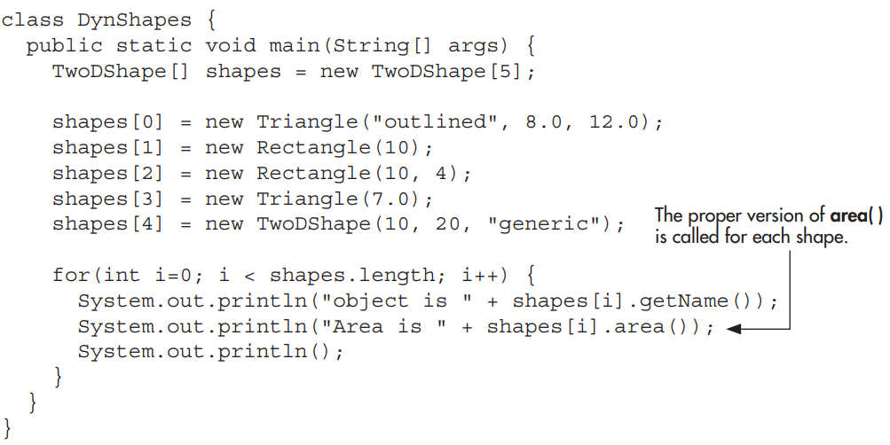

Slide 33
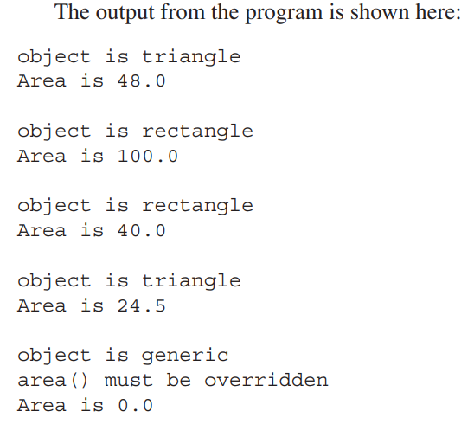

Slide 34

Sometimes you will want to create a superclass that defines only a generalized form that will be shared by all of its subclasses, leaving it to each subclass to fill in the details.
Such a class determines the nature of the methods that the subclasses must implement but does not, itself, provide an implementation of one or more of these methods.

Slide 35
One way this situation can occur is when a superclass is unable to create a meaningful implementation for a method. This is the case with the version of TwoDShape used in the preceding example.
The definition of area( ) is simply a placeholder. It will not compute and display the area of any type of object.

Slide 36
As you will see as you create your own class libraries, it is not uncommon for a method to have no meaningful definition in the context of its superclass.
You can handle this situation in two ways.
One way, as shown in the previous example, is to simply have it report a warning message.

Slide 37
While this approach can be useful in certain situations—such as debugging—it is not usually appropriate.
You may have methods which must be overridden by the subclass in order for the subclass to have any meaning.

Slide 38
Consider the class Triangle. It is incomplete if area( ) is not defined.
In this case, you want some way to ensure that a subclass does, indeed, override all necessary methods.
Java’s solution to this problem is the abstract method.

Slide 39

An abstract method is created by specifying the abstract type modifier.
An abstract method contains no body and is, therefore, not implemented by the superclass.
Thus, a subclass must override it—it cannot simply use the version defined in the superclass.
To declare an abstract method, use this general form:

Slide 40
As you can see, no method body is present.
The abstract modifier can be used only on instance methods. It cannot be applied to static methods or to constructors.

Slide 41
A class that contains one or more abstract methods must also be declared as abstract by preceding its class declaration with the abstract modifier.
. Since an abstract class does not define a complete implementation, there can be no objects of an abstract class.

Slide 42
Thus, attempting to create an object of an abstract class by using new will result in a compile-time error.
When a subclass inherits an abstract class, it must implement all of the abstract methods in the superclass.
If it doesn’t, then the subclass must also be specified as abstract.
Thus, the abstract attribute is inherited until such time as a complete implementation is achieved.

Slide 43
Using an abstract class, you can improve the TwoDShape class.
Since there is no meaningful concept of area for an undefined two-dimensional figure, the following version of the preceding program declares area( ) as abstract inside TwoDShape, and TwoDShape as abstract.
This, of course, means that all classes derived from TwoDShape must override area( ).

Slide 44
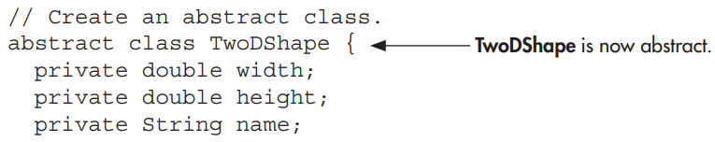
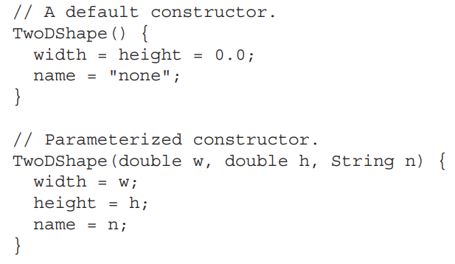

Slide 45
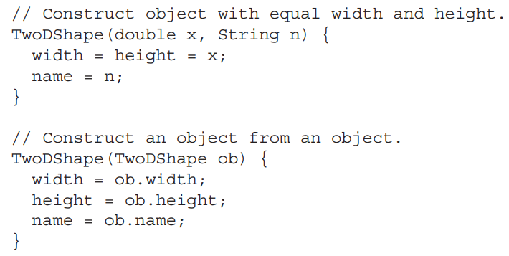

Slide 46
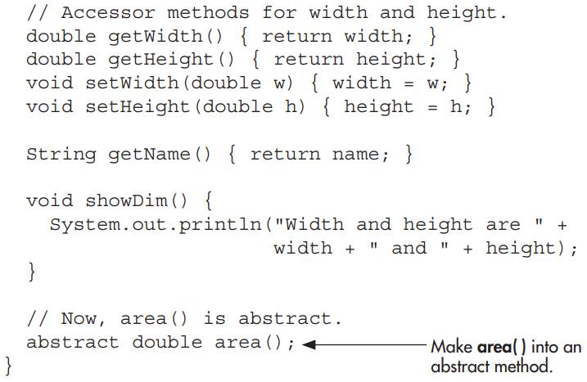

Slide 47
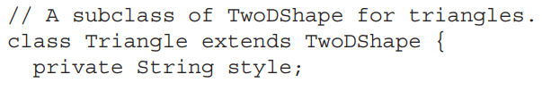
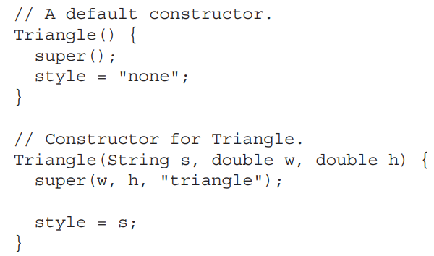

Slide 48
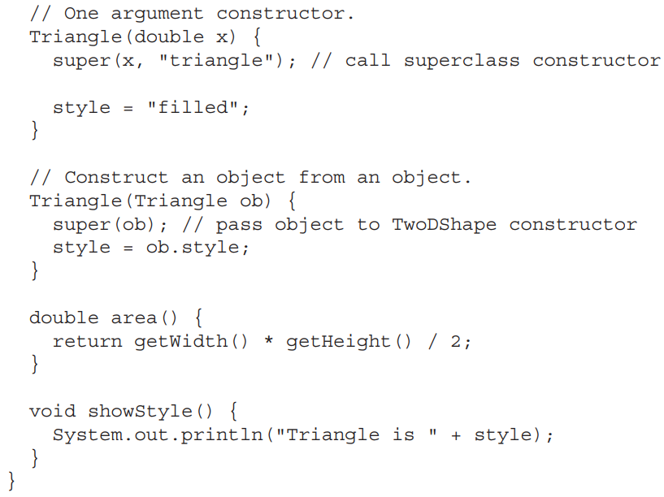

Slide 49
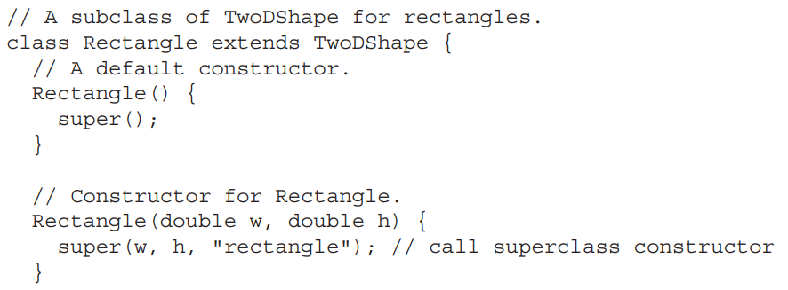

Slide 50
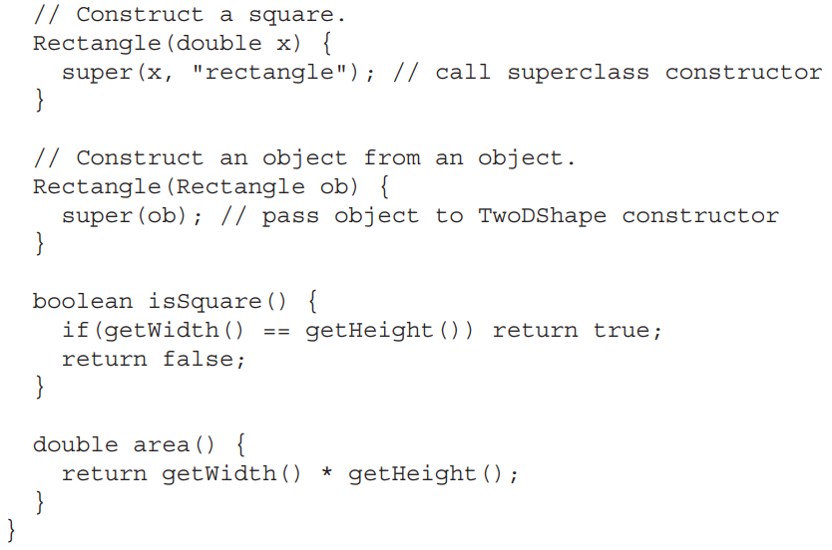

Slide 51
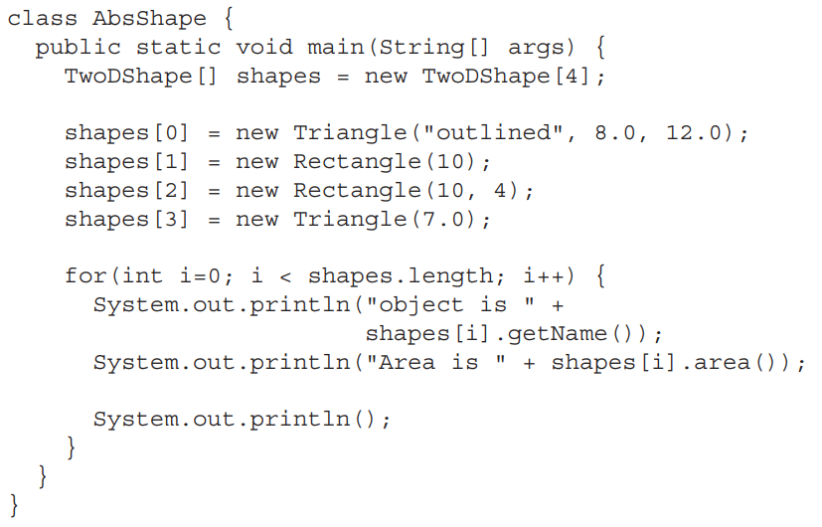

Slide 52
As the program illustrates, all subclasses of TwoDShape must override area( ).
To prove this to yourself, try creating a subclass that does not override area( ).
You will receive a compile-time error. Of course, it is still possible to create an object reference of type TwoDShape, which the program does.
However, it is no longer possible to declare objects of type TwoDShape.

Slide 53
One last point: Notice that TwoDShape still includes the showDim( ) and getName( ) methods and that these are not modified by abstract.
It is perfectly acceptable—indeed, quite common—for an abstract class to contain concrete methods which a subclass is free to use as is.
Only those methods declared as abstract need be overridden by subclasses.

Slide 54

As powerful and useful as method overriding and inheritance are, sometimes you will want to prevent them. For example, you might have a class that encapsulates control of some hardware device.

Slide 55
Further, this class might offer the user the ability to initialize the device, making use of private, proprietary information.
In this case, you don’t want users of your class to be able to override the initialization method.
Whatever the reason, in Java it is easy to prevent a method from being overridden or a class from being inherited by using the keyword final.

Slide 56

To prevent a method from being overridden, specify final as a modifier at the start of its declaration.
Methods declared as final cannot be overridden.
The following fragment illustrates final:

Slide 57
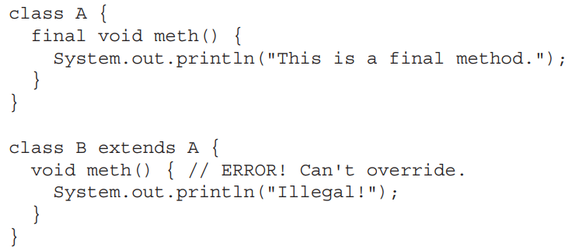

Slide 58

You can prevent a class from being inherited by preceding its declaration with final.
Declaring a class as final implicitly declares all of its methods as final, too.
As you might expect, it is illegal to declare a class as both abstract and final since an abstract class is incomplete by itself and relies upon its subclasses to provide complete implementations.

Slide 59
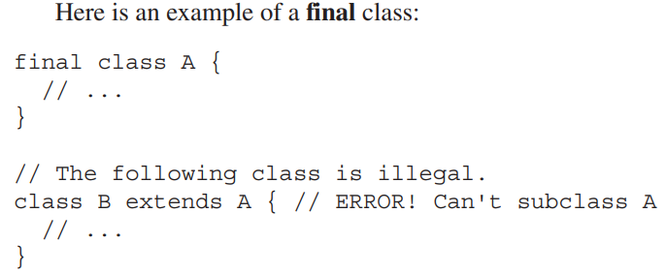

Slide 60
final can also be applied to member variables to create what amounts to named constants.
If you precede an instance variable’s name with final, its value cannot be changed throughout the lifetime of your program.

Slide 61
You can, of course, give that variable an initial value.
For example, in Chapter 6 a simple error-management class called ErrorMsg was shown.
That class mapped a human-readable string to an error code.

Slide 62
Here, that original class is improved by the addition of final constants which stand for the errors.
Now, instead of passing getErrorMsg( ) a number such as 2, you can pass the named integer constant DISKERR.

Slide 63
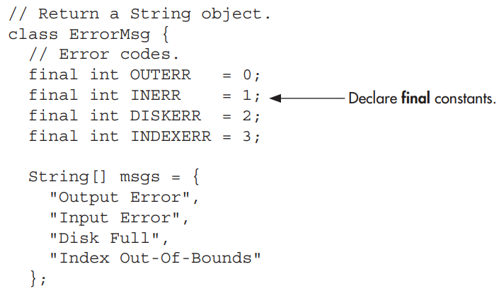

Slide 64
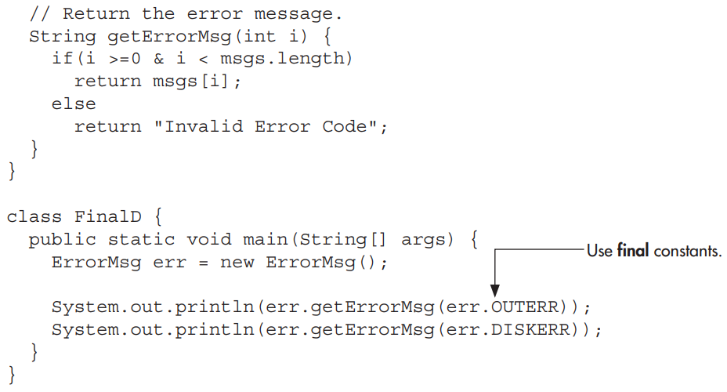

Slide 65

Java defines one special class called Object that is an implicit superclass of all other classes.
In other words, all other classes are subclasses of Object.
This means that a reference variable of type Object can refer to an object of any other class.
Also, since arrays are implemented as classes, a variable of type Object can also refer to any array.

Slide 66
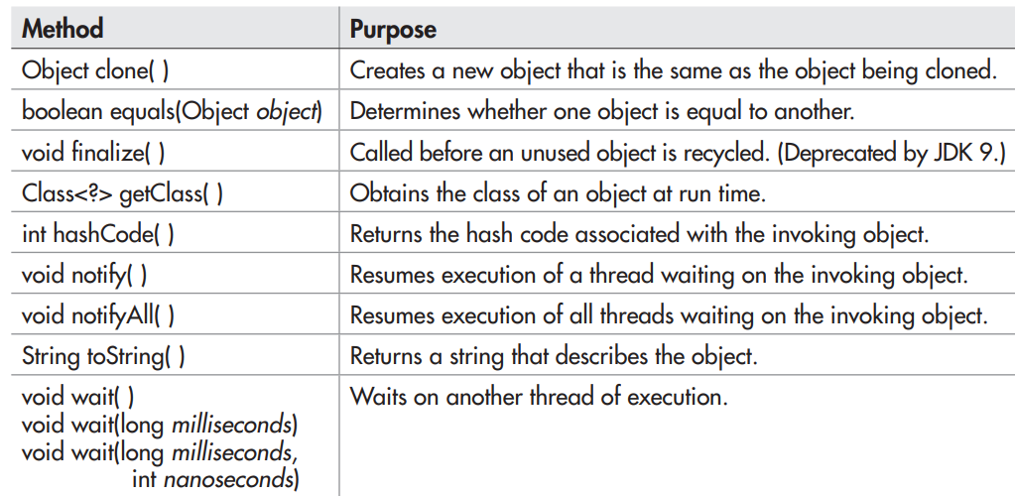
Object defines the following methods, which means that they are available in every object:

